Slide 1


Slide 2
Hello hello, Human! I am so proud of you! We will do a better world together!
Now you will watch a small video about IoT, it is a summary about what is it. Pay attention, in the end of the this level we will have a quiz and if you do it well you you win points!

Slide 3


Sit, relax and watch it!

Slide 4
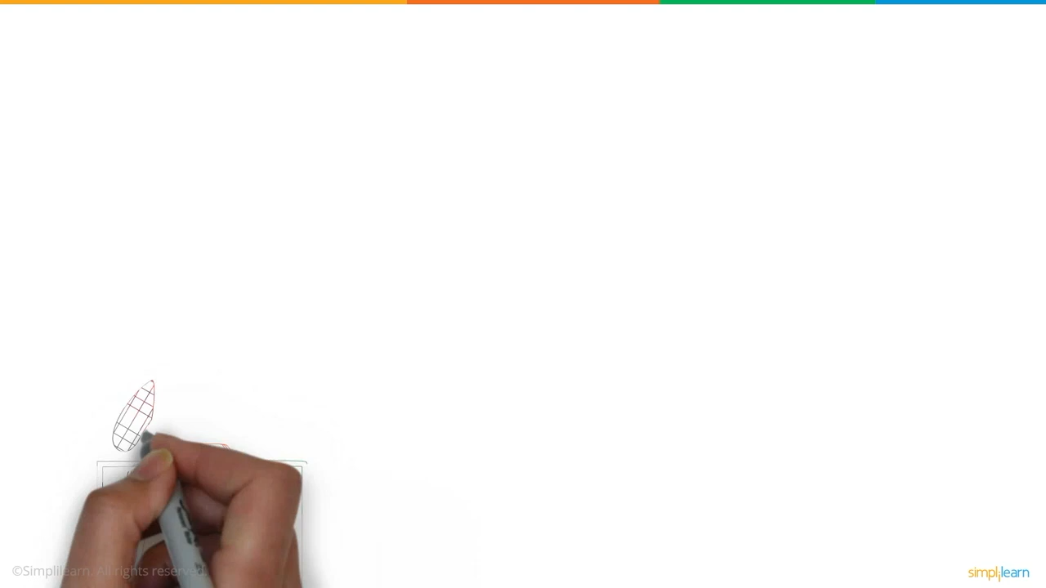

Slide 5

Great job, Human! You got more gold bars! Each new step you are more near to help the world!
See you in task 1.3. Bye!!
You will collect 100 points to finish Task 1.2

